Slide 1
REVOLUTIONIZING CONTENT CREATION: THE POWER OF AI-DRIVEN VIDEO GENERATION

Slide 2
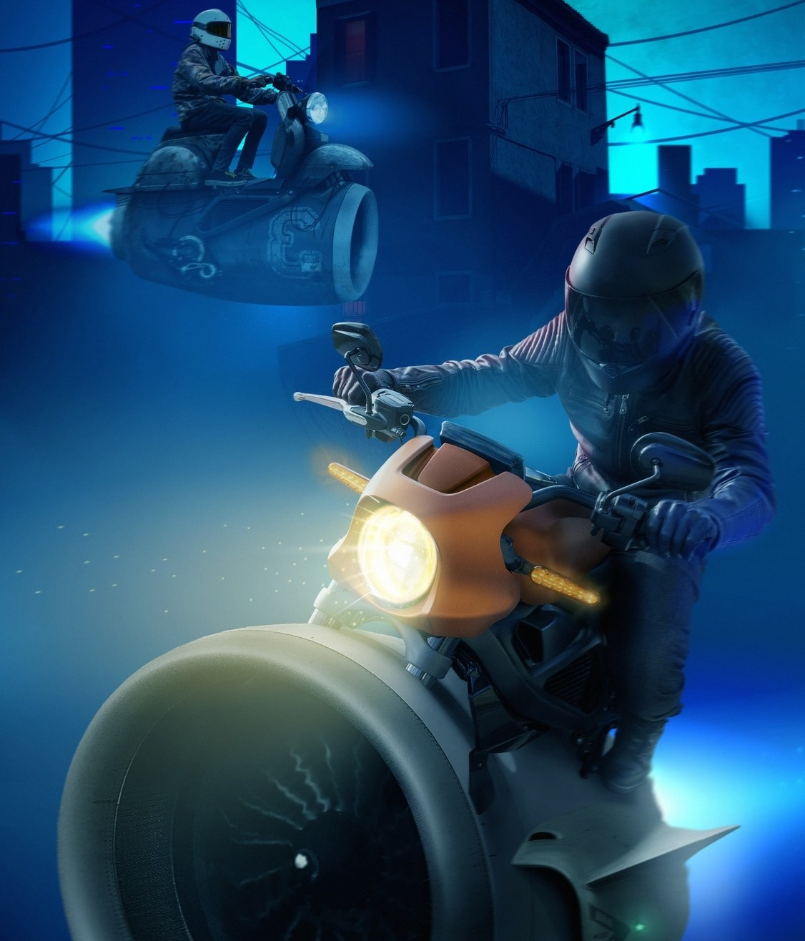
INTRODUCTION
Welcome to the world of AI- driven video generation!
Explore how artiﬁcial intelligence is revolutionizing content creation and reshaping the future of video
production.

Slide 3
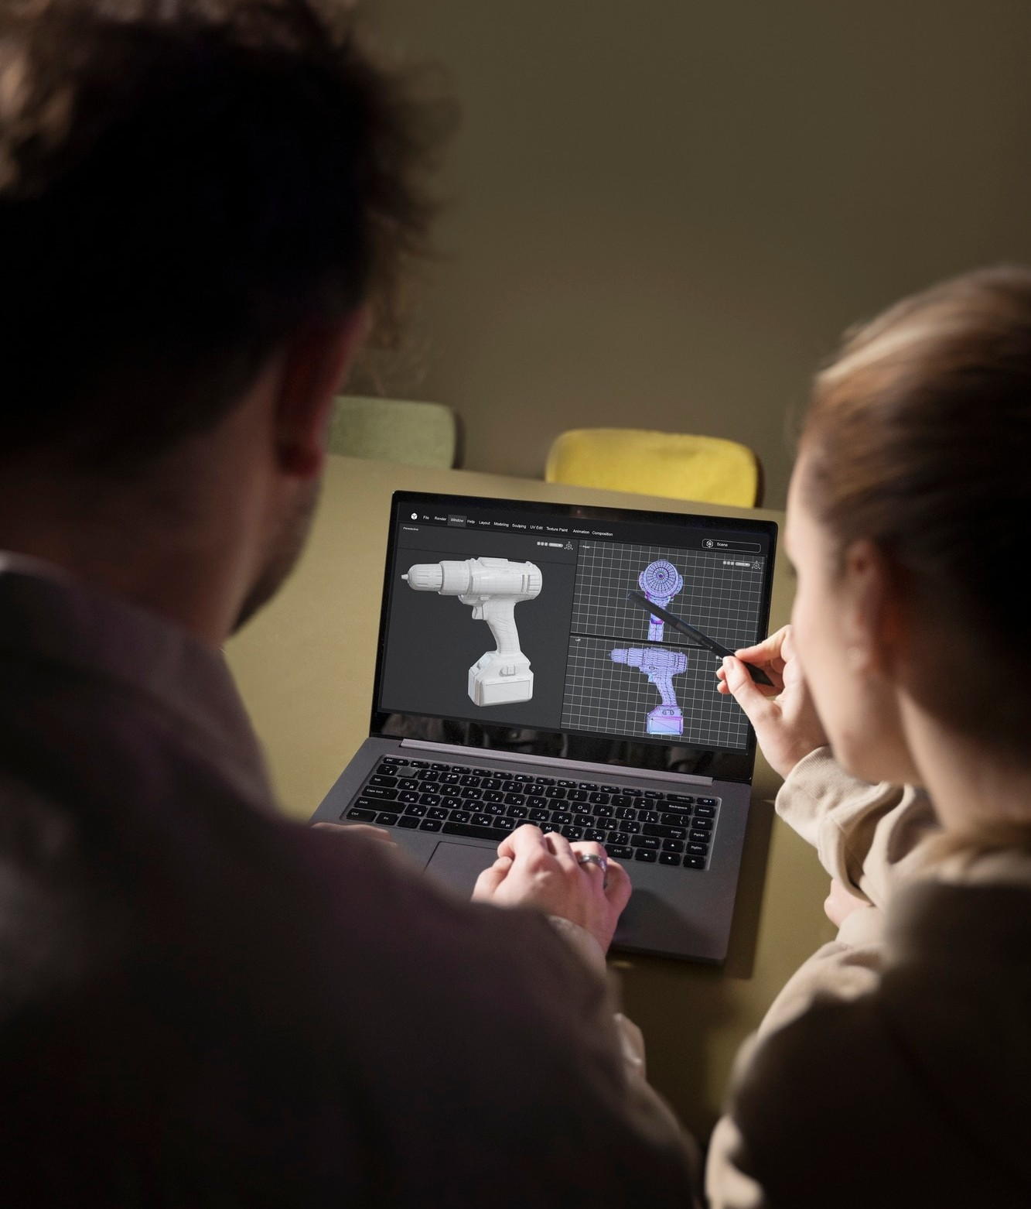
AI IN VIDEO CREATION
Harnessing the power of AI algorithms to automate video production, from scriptwriting to editing. Machine learning enables seamless content generation and customization.

Slide 4
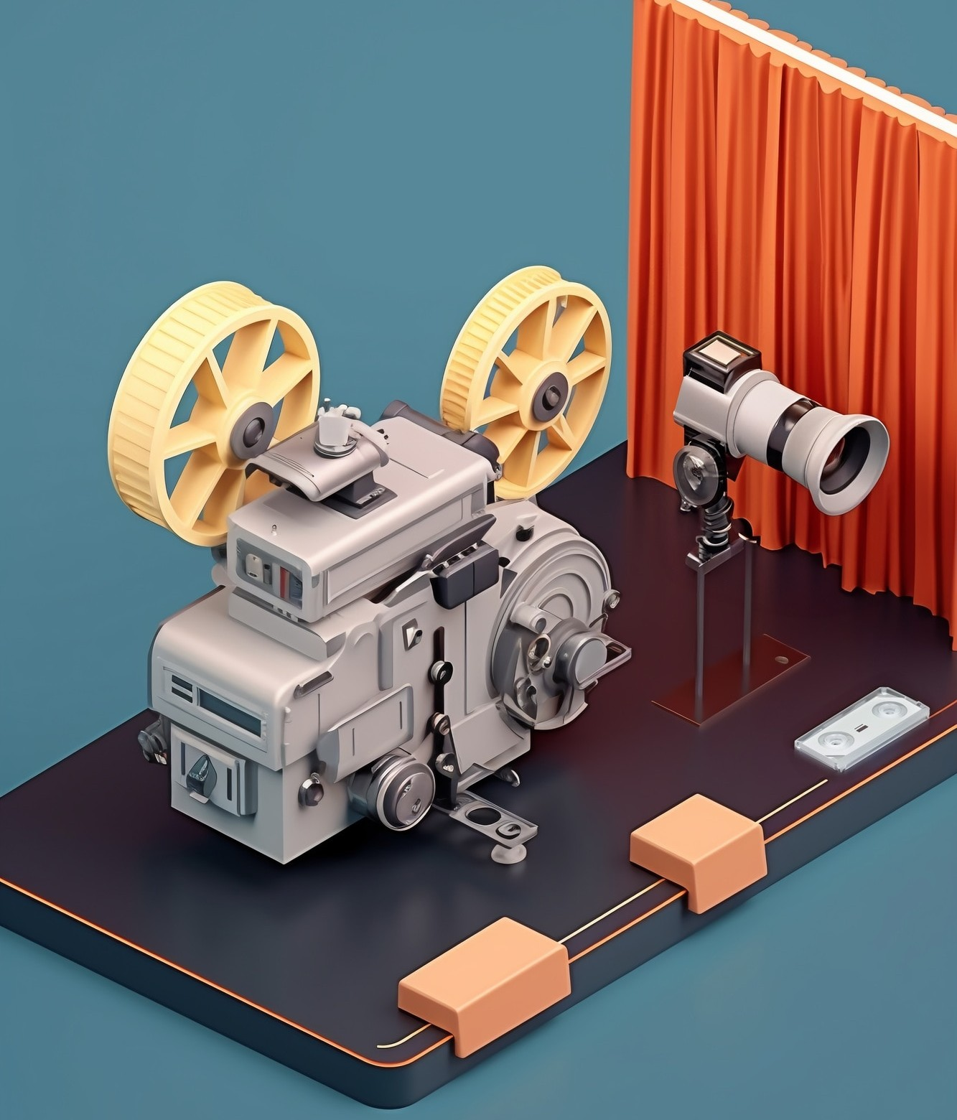
ENHANCED EFFICIENCY
Experience unparalleled efﬁciency with AI-driven video generation, reducing production time and costs while maintaining high- quality output. Embrace the potential for streamlined workﬂows.

Slide 5
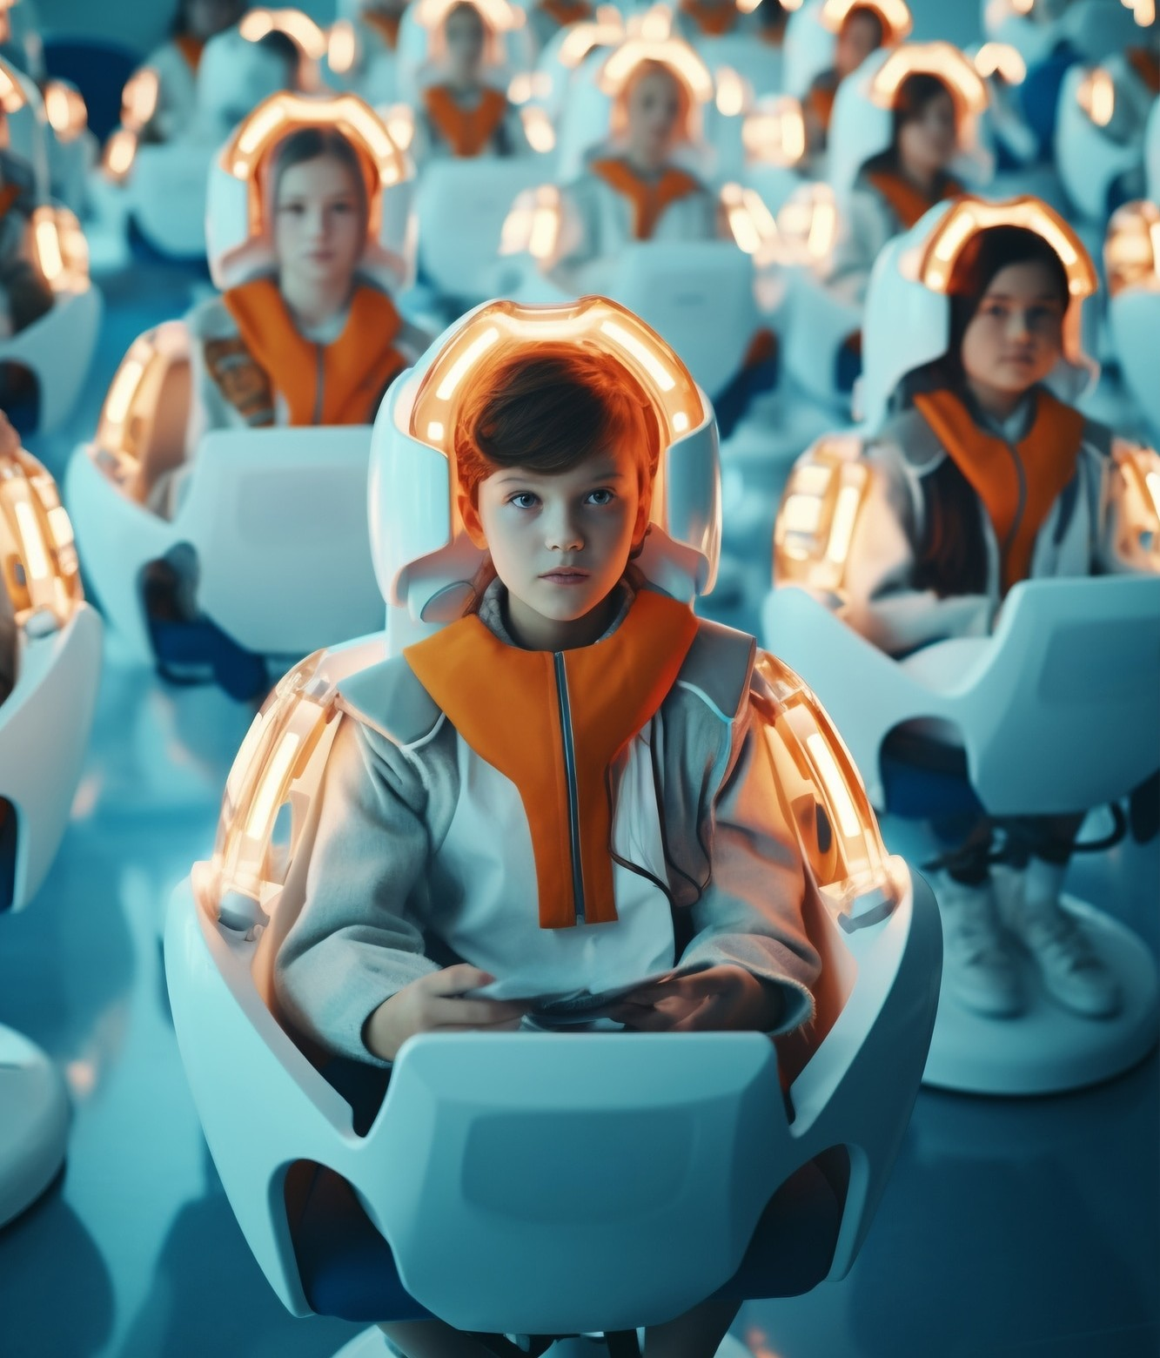
PERSONALIZED CONTENT
Unlock the ability to create personalized video content at scale, catering to diverse audiences with tailored messaging. Embrace the potential for targeted storytelling.

Slide 6
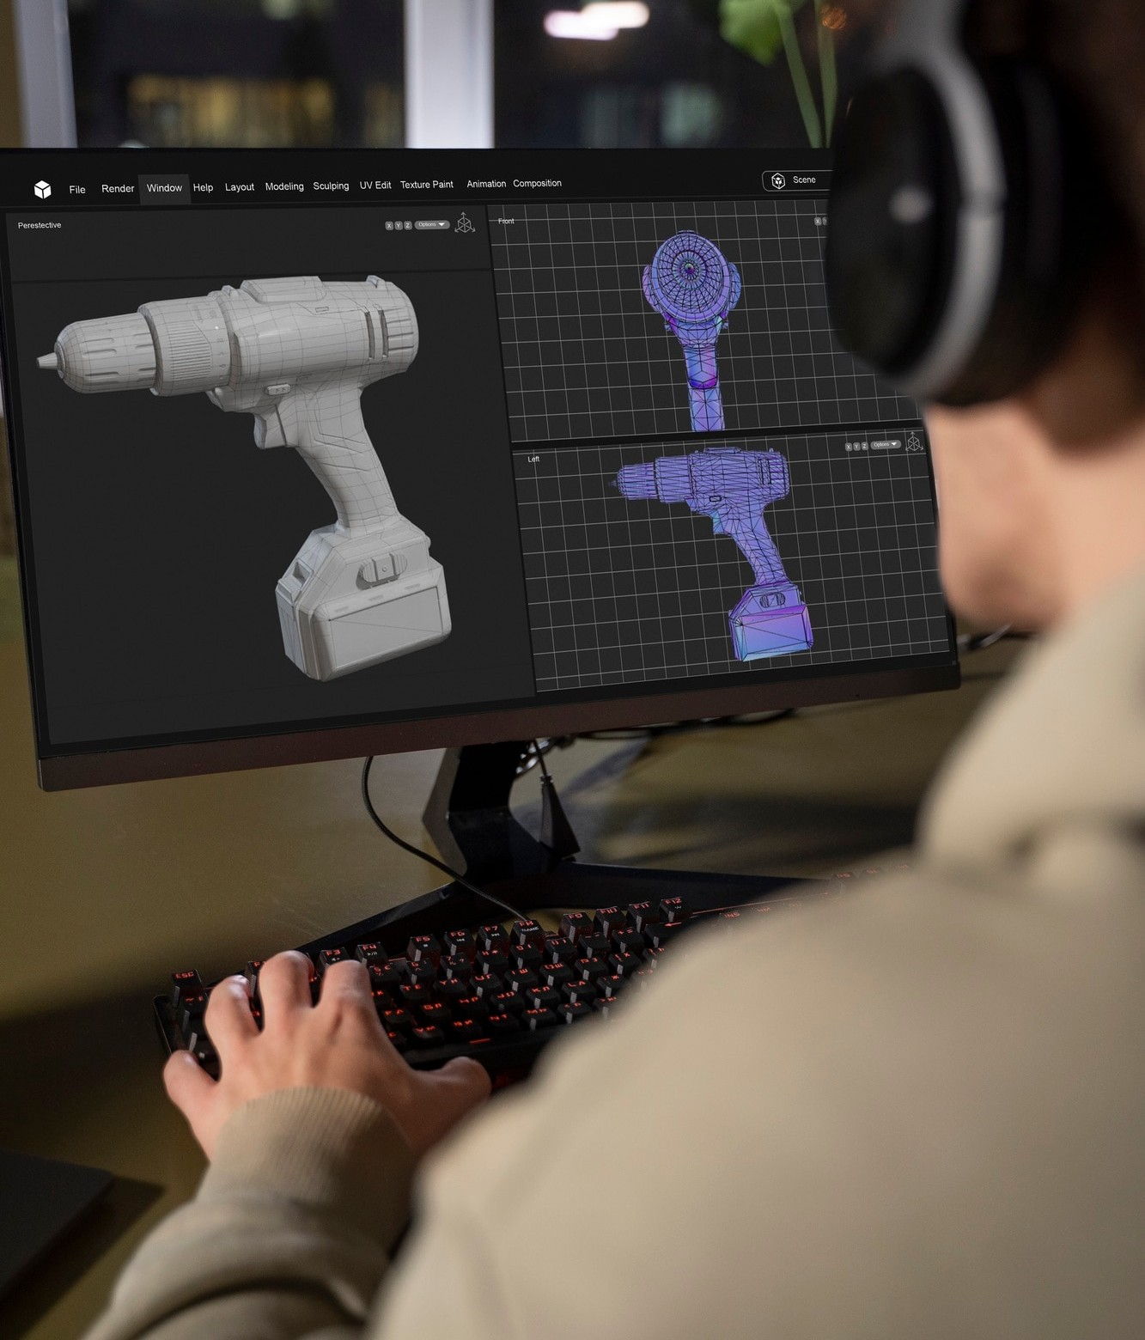
QUALITY ASSURANCE
Leverage AI's ability to ensure consistency and quality control in video production, minimizing errors and optimizing the overall viewing experience.

Slide 7

FUTURE POSSIBILITIES
Explore the limitless potential of AI-driven video generation, from immersive virtual reality experiences to interactive storytelling. Embrace the future of content creation!

Slide 8
CONCLUSION
The power of AI-driven video generation is reshaping the landscape of content creation, offering enhanced efﬁciency, personalized storytelling, and endless creative possibilities. Embrace the future with AI!

Slide 9

Thanks!
Do you have any questions? youremail@email.com
+91 620 421 838
www.yourwebsite.com @yourusername

Slide 10
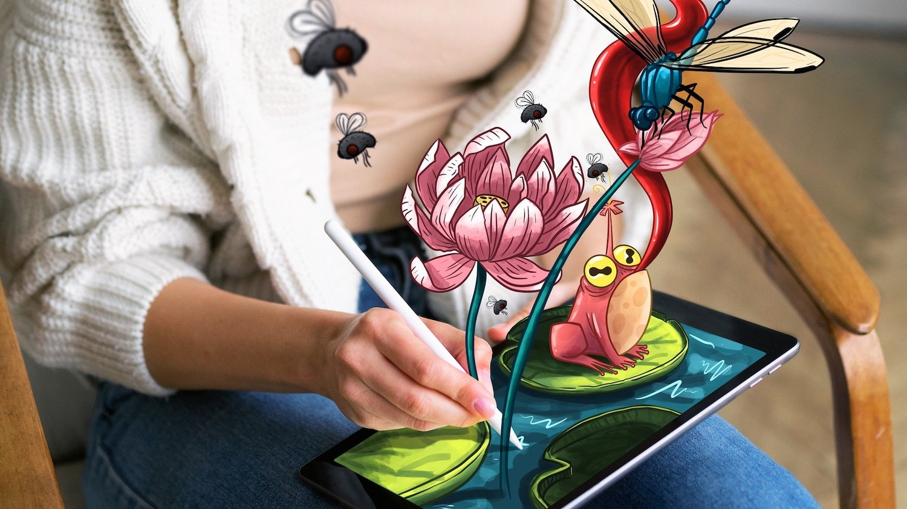
Creative Freedom
Empower creativity with AI tools that facilitate innovative storytelling and visual effects, providing creators with the freedom to explore new realms of artistic expression.

